Slide 1


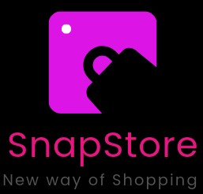


QUANTUM QUAD
SIT (TECH-FRENZY)
Presented by: Lukesh Tiwari

Slide 2
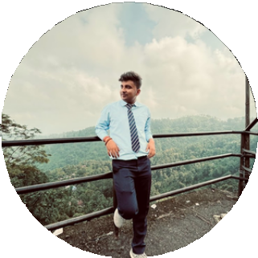
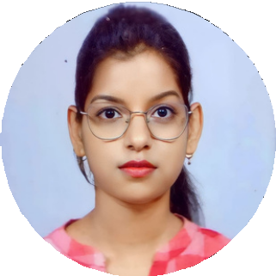
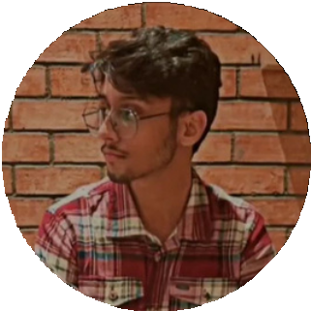
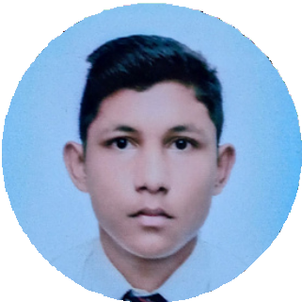
OUR TEAM
Quantum Quad
Presentations are communication tools that can be used as lectures, speeches, reports, and more. It all depends on the purpose of your presentation.
Lukesh Tiwari
Team Leader
Riti Shah
Team Member
Shekhar Pal
Team Member
Jitraj Das
Team Member

Slide 3

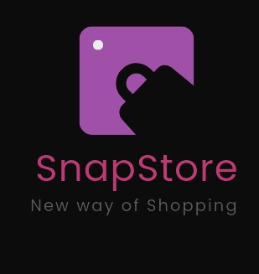

ALL ABOUT THE IDEA 💡
Problem Statement
Shopping Process is a key concern for many customers But they face long queues at the cashier.
This can lead to customer dissatisfaction and potential loss of sales for retailers.
Shop with Trust
Snap and Pay
In Festival Days We Face It Often Regularly.

Slide 4


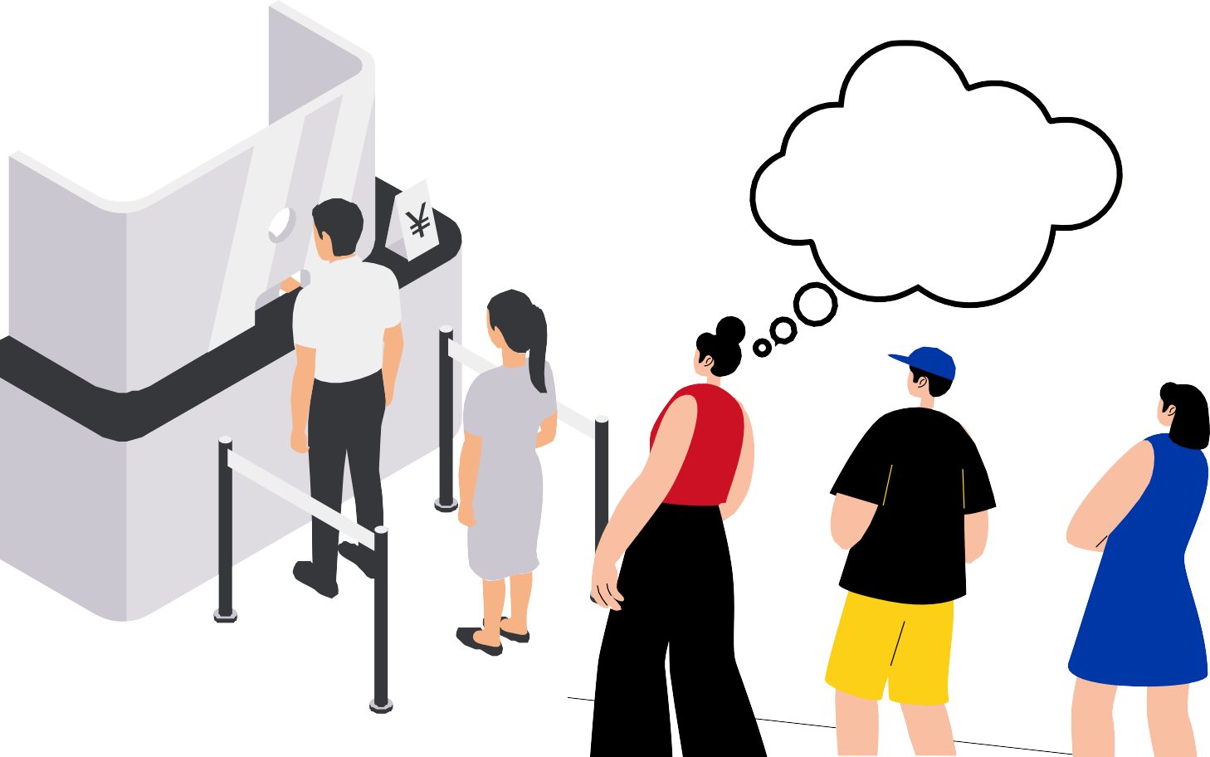

Solution Overview
The SnapStore Offers Streamline Shopping Experience.
The users can simply scan the barcodes of items they want to purchase, add them to their digital cart, and make a direct payment through the app.
This eliminates the need for traditional cashiers, reducing wait times and enhancing convenience.
Long Queue
For Those Who Don’t Scan the Items We Will Use AI and Machine Learning.

Slide 5

Features
Barcode Scanning: Users can scan barcodes of items they want to buy.
Product Listings: The app fetches information about scanned items from an external database.
User Accounts: Users can create accounts, log in, and keep track of their purchase history.
Shopping Cart: Users can add items to their cart and make purchases securely.
Payment Integration: Secure payment processing through integrated payment gateways.

Slide 6



Technologies Used
HTML and CSS: These are fundamental technologies for building the structure and styling of web pages.
JavaScript: Used for client-side scripting to add interactivity and handle events. In this case, JavaScript is used for starting the barcode scanner and handling barcode detection.
QuaggaJS: A barcode scanning library that's integrated into the web page to facilitate barcode scanning.
Libraries and APIs:
QuaggaJS: A JavaScript library for detecting and decoding barcodes. HTML5 APIs: Used for accessing the user's device camera. Media Devices

Slide 7
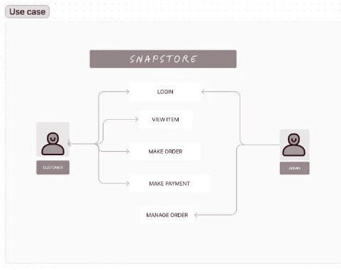
FlowChart
This is the Use Case Diagram of our project.
Here we have two actors namely the customer and the admin.
The customer performs the following operations:
Login
View Item Make Order
Make Payment
Out of which the admin performs performs the operations of aproving login and order management.

Slide 8
Dependencies
Front End - HTML , CSS , Java Script Back End - Express.js
Database - Mongo DB

Slide 9
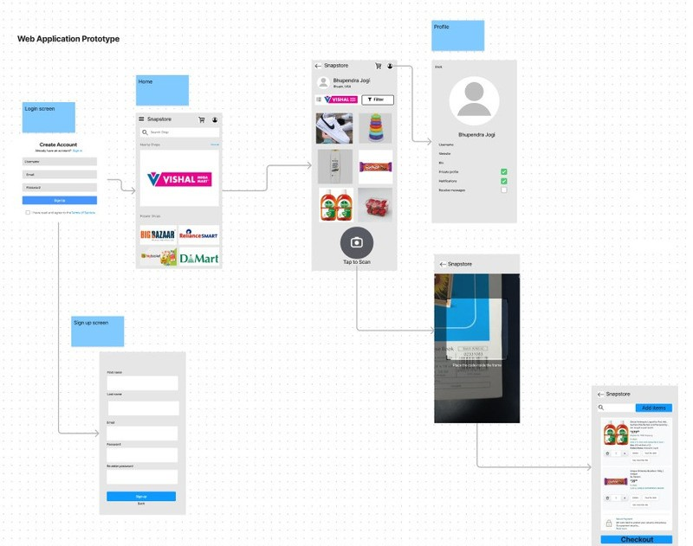
Web Application Prototype

Slide 10
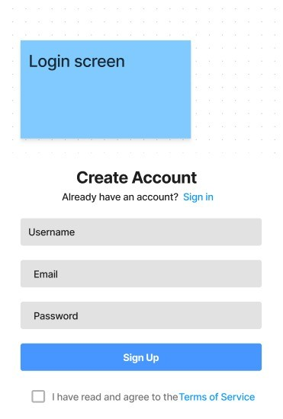
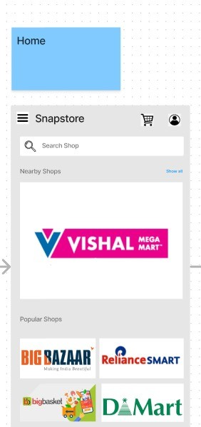
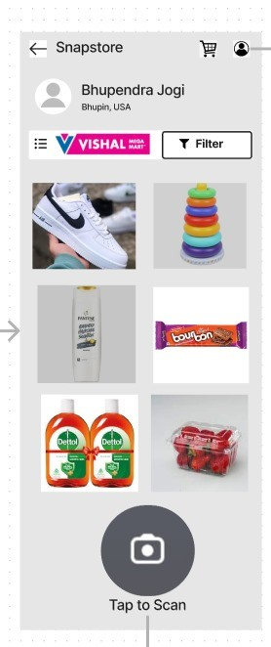
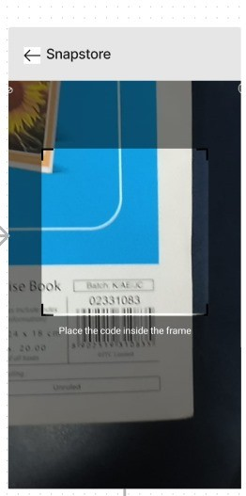
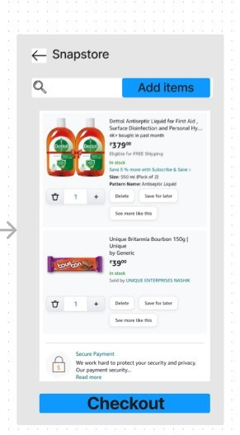
Web Application in Detail

